Slide 1
Web Armour: Unleash the Power of Protection Against Online Threats!
A browser extension for enhanced security

Slide 2
Introduction
The Threats We Face Online
Web Armour - Your Shield Against Online Threats
Phishing Website Blocking
Password Strength Checking
Email Breach Monitoring
Ad Blocker
Why Web Armour is the Best Choice for Online Security
Conclusion
Q&A

Slide 3

Introduction
Welcome to our presentation on online security. In today's digital age, the internet has become an integral part of our lives. From shopping to banking, we rely on the internet for almost everything. However, with this convenience comes the risk of cyber threats that can compromise our personal information and privacy.
That's why it's crucial to protect yourself while browsing the internet. In this presentation, we will introduce you to Web Armour, your ultimate shield against online security risks.

Slide 4

The Threats We Face Online
As we navigate the vast and ever-evolving landscape of the internet, we must be aware of the multitude of threats that lurk in its depths. From phishing scams designed to trick us into divulging sensitive information, to weak passwords that leave us vulnerable to hacking attempts, to malware that can infect our devices and steal our data, the dangers are all too real.
But fear not, for knowledge is power. By understanding the risks and taking proactive measures to protect ourselves, we can navigate the digital world with confidence and peace of mind.

Slide 5

Web Armour: Your Ultimate Shield
Web Armour is the ultimate shield against online security risks. Its advanced features provide comprehensive protection against phishing attacks, compromised passwords, email hacks, and intrusive ads.
With Web Armour, you can browse the internet with confidence, knowing that your personal information and sensitive data are secure. Its powerful algorithms identify and block suspicious websites, alert you if your passwords have been compromised, monitor your email for hacks, and block annoying ads from third-party websites.

Slide 6
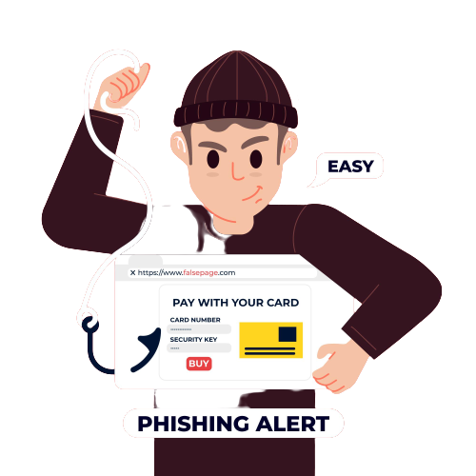
Phishing Protection
Web Armour uses advanced algorithms to detect and block phishing attacks. When you visit a website, Web Armour checks it against a database of known phishing sites and alerts you if it is suspicious. It also analyzes the website's content and behavior to identify any signs of phishing activity.
If Web Armour detects a phishing attempt, it blocks access to the site and displays a warning message. This prevents you from accidentally entering your personal information on a fake website. With Web Armour, you can browse the internet with confidence, knowing that you are protected from phishing attacks.

Slide 7

Password Security
Web Armour takes password security seriously. It uses advanced algorithms to check the strength of your passwords and alerts you if they have been compromised in a data breach.
The tool checks for factors such as length, complexity, and uniqueness to determine how strong a password is. It then provides users with suggestions on how they can improve their password, such as adding numbers or special characters, or avoiding common words or phrases.

Slide 8

Email Breach Monitoring
Web Armour's email monitoring feature is a powerful tool in protecting your online security. It scans your inbox for any signs of compromise, such as suspicious activity or unauthorized access attempts. If it detects anything unusual, it immediately alerts you and provides guidance on how to secure your account.
This feature not only helps prevent data breaches but also gives you peace of mind knowing that your sensitive information is being monitored around the clock. With Web Armour's email monitoring, you can rest assured that your online identity is safe and secure.

Slide 9

Ad-Blocking
Web Armour's ad-blocking feature ensures that you are not bombarded with intrusive ads from third-party websites while browsing the internet. This not only makes your online experience more pleasant but also protects your privacy and security.
Analyze strength and security of user passwords
Detect if passwords have been compromised
Provide recommendations for stronger passwords
Web Armour ensures password security

Slide 10
Why Web Armour is the Best Choice for Online Security…
Web Armour offers comprehensive protection against online threats, including phishing scams, weak passwords, and malware.
Integration with Browsers
Seamless integration with popular web browsers
Available for Chrome, Firefox, and Safari
Instantly access Web Armour's features
Web Armour works across multiple platforms

Slide 11
Conclusion
In conclusion, it's clear that online security is more important than ever. With the rise of cyber threats such as phishing scams, weak passwords, and malware, it's crucial that we take steps to protect ourselves while browsing the internet.
Thankfully, Web Armour offers a comprehensive solution for online security, with features such as phishing website blocking, password strength checking, email breach monitoring, and an ad blocker. By using Web Armour, you can feel confident that your online activity is protected from malicious threats.

